Slide 1
DATA MODELING
IN
MACHINE LEARNING
BY
GANIYU OLALEKAN

Slide 2
WHAT IS DATA MODELING IN MACHINE LEARNING
Data modeling in machine learning is the process of creating machine learning models capable of predicting labels from features, tuning them for the business need, and validating it on holdout data. The output from data modeling is a trained model that can be used for making predictions on new data points.

Slide 3
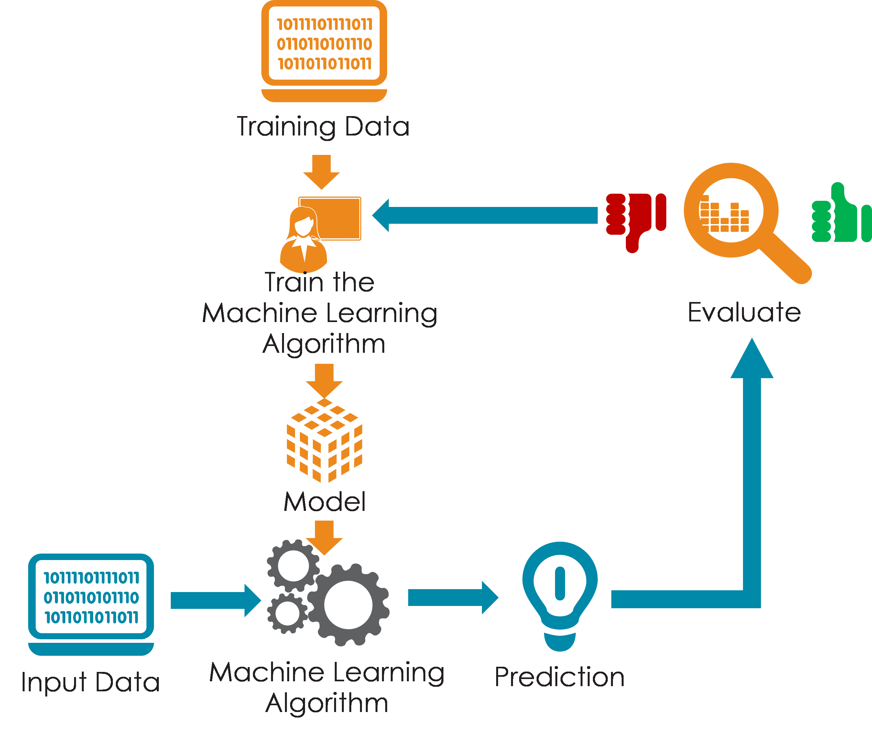
WHY DO WE MODEL DATA IN MACHINE LEARNING?
Machine learning aims to create models that mimic understanding of real-world situations through data and apply that understanding to real-world scenarios.
We model data to create a bridge (pipeline) between the dataset and the machine learning model, such that new data can be quickly received and translated to results.

Slide 4
STEPS IN MODELING DATA IN MACHINE LEARNING
Prepare the data
Fine-Tune The system
Present Your Solution
Shortlist Promising Models
Create a Pipeline For The Model

Slide 5


SCIKIT-LEARN FOR MACHINE LEARNING
What is Scikit-Learn?
Scikit-Learn is a python package that houses a series of machine learning algorithms (alongside other useful algorithms) to perform machine learning functions.
Why Scikit-Learn?
Scikit-Learn is a simple and efficient tool for predictive data analysis, accessible to everybody, and reusable in various contexts.
It is built on NumPy, SciPy, and Matplotlib.

Slide 6
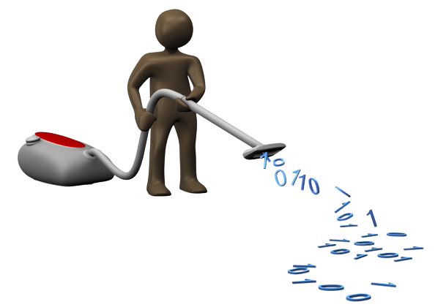
PROCESSES IN DATA PREPARATION
Data cleaning
Fix or remove outliers (optional).
Fill in missing values (e.g., with zero, mean, median…) or drop their rows (or columns).
Feature selection (optional)
Drop the attributes that provide no useful information for the task.

Slide 7

PROCESSES IN DATA PREPARATION
Feature engineering, where appropriate:
Discretize continuous features.
Decompose features (e.g., categorical, date/time, etc.).
Add promising transformations of features (e.g., log(x), sqrt(x), x2, etc.).
Aggregate features into promising new features.
Feature scaling:
Standardize or normalize features.

Slide 8

Shortlist Promising Models
Train many quick-and-dirty models from different categories (e.g., linear, naive Bayes, SVM, Random Forest, neural net, etc.) using standard parameters.
Measure and compare their performance.
For each model, use N -fold cross-validation and compute the mean and standard deviation of the performance measure on the N folds.
Analyze the most significant variables for each algorithm.
Analyze the types of errors the models make.
What data would a human have used to avoid these errors?
Perform a quick round of feature selection and engineering.
Perform one or two more quick iterations of the five previous steps.
Shortlist the top three to five most promising models, preferring models that make different types of errors.

Slide 9

Shortlist Promising Models
After shortlisting models, we'll be performing a series of actions to check for the model performance before we select a model for our task.
This process is called Model Selection.
I wrote an article on the Steps Involved in Selecting a Model which should better explain this concept.

Slide 10

Fine-Tune The system
Fine-tune the hyperparameters using cross-validation:
Treat your data transformation choices as hyperparameters, especially when you are not sure about them (e.g., if you’re not sure whether to replace missing values with zeros or with the median value or to just drop the rows).
Unless there are very few hyperparameter values to explore, prefer random search over grid search. If training is very long, you may prefer a Bayesian optimization approach (e.g., using Gaussian process priors, as described by Jasper Snoek et al. ).
Try Ensemble methods. Combining your best models will often produce better performance than running them individually.
Once you are confident about your final model, measure its performance on the test set to estimate the generalization error.

Slide 11

Create a Pipeline For The Model
After fine-tuning the model, it is essential to create a pipeline that handles all the processes of cleaning, selecting features, and engineering feature.
Ultimately, the purpose of a pipeline is to allow you to increase the iteration cycle with the added confidence that simplifying the process gives and to scale how many models you can realistically maintain in production.

Slide 12

Present Your Solution
Document what you have done.
Create a nice presentation.
Make sure you highlight the big picture first.
Explain why your solution achieves the business objective.
Don’t forget to present interesting points you noticed along the way.
Describe what worked and what did not.
List your assumptions and your system’s limitations.
Ensure your key findings are communicated through beautiful visualizations or easy-to-remember statements (e.g., “the median income is the number-one predictor of housing prices”).

Slide 13
CONCLUSION
I believe the concept of data modeling in machine learning has been properly resolved. We’ve also looked into why we model data in machine learning.
We talked about the steps necessary in modeling data for machine learning models. These steps were taken from Aurélien Géron in his book Hands-On Machine Learning with Scikit-Learn, Keras, and TensorFlow, where he gave a full checklist of handling any machine learning projects (Do check out his book)
This concludes the slides on data modeling.

Slide 14

THANK YOU!!!

